Slide 1
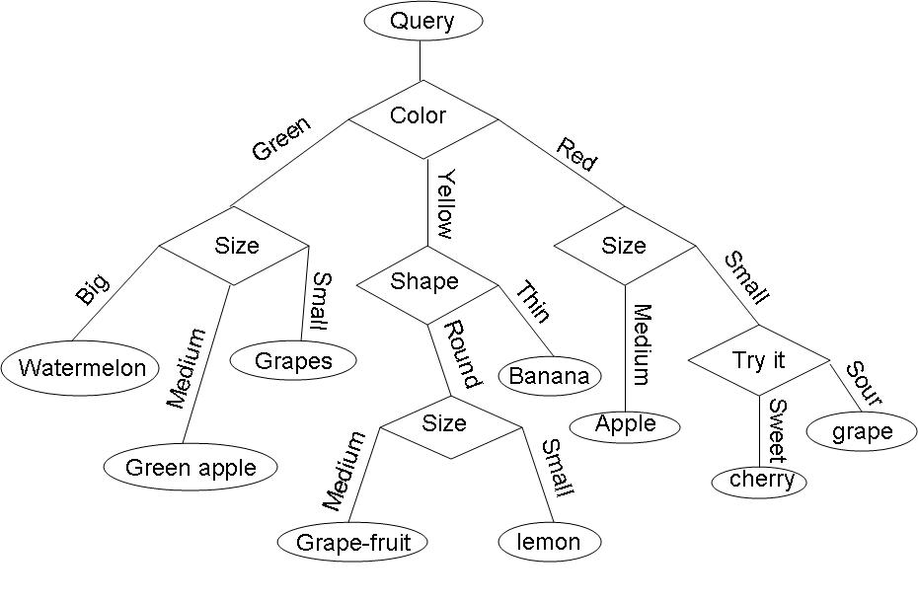
Decision Trees: Now, let’s move beyond thinking in terms of Regression Models

Slide 2
Expanding our “repertoire” of models
In last class we covered how we can create linear predictive models using regression. Such models are only one type of model
Another common model using in machine learning/data analytics is a “Decision Tree”

Slide 3
Introduction to Decision Trees
Decision tree learning is a supervised learning technique aiming at the classification of cases based on input variables.
Decision trees can include multiple input variables
They can predict one categorical target variable
…but, keep in mind that it is often appropriate to transform a continuous variable into categorical, i.e. old/young, new/old, big/small, quartile, etc.
The resulting decision model is arranged in the form of a tree.

Slide 4
Introduction to Decision Trees
Decision trees work by identifying splitting rules in our data.
The guiding measure used is a measure of disorder.
Lower disorder points toward more organized data.
Therefore, rules that reduce disorder are an indication that we’ve gained some information about the data.
We have a number of measures of disorder. The two most common are Entropy and GINI index.
We also have a number of algorithm choices such ID3, (or other algorithms such a CART) THAT guide the selection of rules.

Slide 5
Measures of disorder
Entropy
Originated in Physics
Commonly used in other fields, especial in information theory.
Information theory attempts to efficiently code complicated sets of data using simpler sets.
Gini Index
Originated in Economics
It’s a measure of dispersion, originally developed to measure income distribution.

Slide 6
Decision tree algorithms
There are a number of algorithms that can be used
The most common is ID3 (another is CART)
Each approach seeks to reduce disorder in the data sets (reduce the measure of entropy or decrease Gini index).
Decision tree identification requires a search for splits in the data that result in a reduction in disorder of the data.
Each feature (input) of the data is searched to identify a single split that results in identifying a subset of the data with the smallest disorder. The process is then recursively applied to the remaining set of data.
The number of rules identified is typically restricted by the analyst.
As with regression modeling, too much complexity typically results in overfitting. In the case of decision trees, too many rules (levels) results in overfitting.

Slide 7
Let’s illustrate by using an example
Objective is to study the effects of drinking, smoking, and body weight on life effects. We are given data on 55 60 recently deceased persons.
Drinker | Smoker | Weight | Age
No | No | 56 | 87
Yes | No | 123 | 61
Yes | No | 88 | 67
No | No | 123 | 67
No | Yes | 88 | 68
No | Yes | 67 | 65
Yes | Yes | 115 | 56
Yes | No | 110 | 76
Etc.
(see health.csv on cuLearn)
Question we may ask:
What factors (between Drinking, Smoking, and Weight) influence person's life expectancy the most?

Slide 8
Let’s illustrate by using an example
Using decision trees, we develop a classification model the segments our data set into young or old deaths based on key influencing factors.
1st, we can simply classify “Early Death” as anyone that died before 70.
=IF(E2<70,1,0)
This results in a new excel table
Drinker | Smoker | Weight | Age | Early Death
No | No | 56 | 87 | 0
Yes | No | 123 | 61 | 1
Yes | No | 88 | 67 | 1
No | No | 123 | 67 | 1
No | Yes | 88 | 68 | 1
No | Yes | 67 | 65 | 1
Yes | Yes | 115 | 56 | 1
Yes | No | 110 | 76 | 0
Etc.

Slide 9
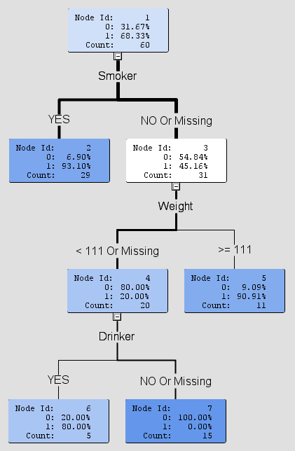
Let’s illustrate by using an example
This is an example DecisionTree Model.
It attempts to predict a binary outcome by applying decision rules to the input data.
Etc.

Slide 10
Let’s illustrate by using an example
60 Observations
68.33% Early Death
93.1% of smokers died young
Use Binary variable Smoker to Split the Data. 29 Are Smokers, and 31 are not.
Use Weight to Split the Data. Of 31 non-smokers, 11 are over 111kgs
90.91% of non-smokers over the weight of 111kgs died young
Use Binary variable Drinker to Split the set of individuals that do not smoke, and are under 111kgs
4 out of 5 Non-Smoking individuals under 111kgs that drank died young.
Etc.
All Non-Smoking, Non-Drinking individuals under 111kgs lived long (>=70 yrs)

Slide 11
Testing our Model: Now, test out model on unobserved data.

Slide 12
Model Test #1
New Observation:
Mr. Jones. He Drinks, Smokes, weighs 120kgs and died at 65
Does our Model Classify this new observation correctly?

Slide 13
Model Test #1
New Observation:
Mr. Jones. He Drinks, Smokes, weighs 120kgs and died at 65
✓
Does our Model Classify this new observation correctly?
YES!

Slide 14
Model Test #2
New Observation:
Ms. Johnson. She’s a non-smoker, non-drinker, that weighs 60kgs and died at 85
Does our Model Classify this new observation correctly?

Slide 15
Model Test #2
New Observation:
Ms. Johnson. She’s a non-smoker, non-drinker, that weighs 60kgs and died at 85
Does our Model Classify this new observation correctly?
YES!
✓

Slide 16
Model Test #3
New Observation:
Mr. Williams He’s a non-smoker, that weighs 120kgs and died at 85
Does our Model Classify this new observation correctly?

Slide 17
Model Test #3
New Observation:
Mr. Williams. He’s a non-smoker, that weighs 120kgs and died at 85
Does our Model Classify this new observation correctly?
NO!
☒

Slide 18
Measuring the Performance of a Classifying Model (such as a Decision Tree)
Confusion Matrix for a two category classifier predictive model
tp = true positives: positive instances predicted to be positive (sometimes referred to as “hits”)
tn = true negative: negative instances predicted to be negative (sometimes referred to as “rejections”).
fp = false positive: negative instances predicted to be positive (sometimes referred to as “false alarms”, or Type I errors)
fn = false negative: positive instances predicted to be negative (sometimes referred to as “misses”, or Type II error)

Slide 19
Common Assesment Measures
Measure | Formula
error | (fp+fn)/N
Accuracy | (tp+tn)/N
tp-rate/hit-rate/sensitivity | tp/p
tn-rate/specificity | tn/n
fp-rate/false-alarm rate | fp/p
Precision | tp/p`
F-Score | precision * recall
tp = true positive/hits
tn = true negative/rejections
fp = false positive/false alarms
fn = false negative/misses
N = total cases in our training set
p = total positives in training set
n = total negatives ‘ ‘
p`= total positives predicted by our model
n`= total negatives predicted by our model
…etc.

Slide 20
Measuring the performance of our new Decision Tree model
Young
#Young=27
#Old=2
Young
#Young=10
#Old=1
Young
Old
#Young=4
#Old=1
#Young=0
#Old=15
Error | (fp+fn)/N | (4+0)/60 | 0.067
Accuracy | (tp+tn)/N | (41+15)/60 | 0.933
tp-rate | tp/p | 41/41 | 1.000
fp-rate | fp/p | 0/41 | 0.000
precision | tp/p` | 41/45 | 0.911
F-Score | precision*recall | 1*0.911 | 0.911

